Slide 1
NE 591: Advanced Reactor Materials
Fall 2021
Dr. Benjamin Beeler

Slide 2
Last Time
Background and history of HTGRs/TRISO particles
Difference from LWRs
helium cooled; much higher temperatures; thermal/fast options; extensive utilization of graphite; flexibility of fuel
Fuel Kernel
oxides and carbides
oxides have better fission retention, carbides don’t produce CO
US uses UCO, UC2 being consumed over time
oxygen potential will govern CO production
CO production can cause failure

Slide 3
Silicon Carbide

Slide 4
Silicon Carbide (SiC)
SiC is a very hard and strong non-oxide ceramic that possesses unique thermal and electronic properties
Polycrystalline SiC has a strength of 15 GPa and has excellent creep resistance
SiC’s upper limit of stability is around 2500C and has a melting temperature of around 2830C
SiC also has excellent thermal conductivity
SiC is a highly covalent material that forms tetrahedra that are centered around either carbon or silicon atoms
β-SiC takes the diamond cubic structure with half of the carbons being replaced with silicon; this is a very stable structure that is conducive to phononic heat conduction

Slide 5
Silicon Carbide (SiC)
Silicon carbide (SiC) has been studied and utilized in nuclear systems for decades, primarily as the micro pressure vessel for high-temperature gas-cooled reactor fuels
The SiC must be strong enough to withstand the pressure buildup from the fission product gas liberated and CO produced
The SiC layer must withstand chemical attack from metallic fission products such as palladium
The SiC must be able to handle the mechanical loads derived from irradiation-induced dimensional changes occurring in the pyrolytic graphite
The SiC must maintain its properties during irradiation

Slide 6
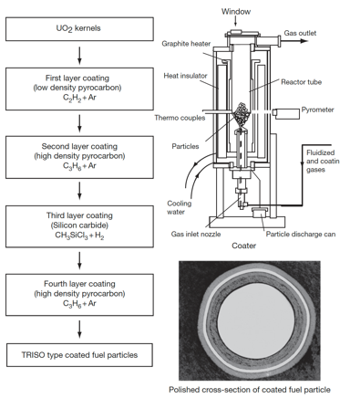
SiC (and PyC) Fabrication
The coating technology of both the SiC and PyC layers involves a fluidization of the kernel microsphere bed and chemical vapor deposition (CVD) coating
TRISO coating process is divided into four coating processes for the porous PyC, IPyC, SiC, and final OPyC layers
A specific mixture of gases is used for the deposition of each layer
buffer: C2H2+Ar; IPyC/OPyC: C3H6+Ar; SiC: CH3SiCl3+H2

Slide 7
Radiation Effects in SiC
The neutron-induced swelling of SiC has been well studied for low and intermediate temperatures (up to 1000 C)
It is well understood that the presence of significant second phases and/or poorly crystallized phases in these materials leads to unstable behavior under neutron irradiation
While high purity, stoichiometric, near-theoretical density SiC can show excellent radiation resistance
Here I will be talking about the good SiC, assuming that the fabrication process has produced appropriately clean coatings

Slide 8
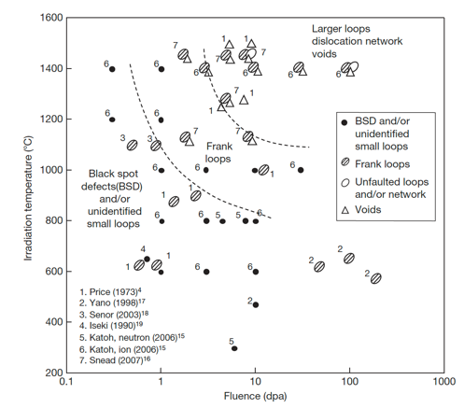
Radiation Effects in SiC
The microstructural evolution map is shown on the right
The contribution of the defects themselves to the swelling in SiC is not well understood

Slide 9
Low T Radiation Effects in SiC
Below 400 K, neutron irradiated SiC microstructure is described as black spot defects, which are most likely clusters of self-interstitial atoms
For irradiation temperatures less than about 423 K, accumulation of strain due to the irradiation-produced defects can exceed a critical level above which the crystal becomes amorphous
The swelling under self-ion irradiation increases logarithmically with dose until amorphization occurs
The swelling of neutron- and ion-amorphized SiC has been reported to be as high as 10.8% at 343K

Slide 10
Low-Med T Radiation Effects in SiC
Above the critical amorphization temperature (423 K), the swelling increases logarithmically with dose until it reaches saturation
The saturation level decreases with increasing irradiation temperature
The dose exponents of swelling during the log period are often close to 2/3, in line with assumptions based on interstitial clusters
This temperature regime is referred to as the point-defect swelling regime and goes from critical amorphization temperature to about 1273 K
Tirr=300 C, 6 dpa
Dot number density 2.2e+24m-3
Mean dot diameter=1nm
Tirr= 800 C, 7.7 dpa
Loop number density 3.3e+23m-3
Mean loop diameter = 3.0 nm

Slide 11
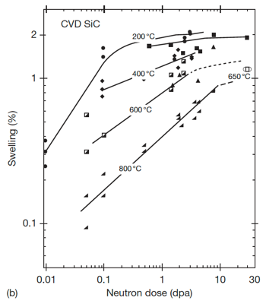

Saturation Swelling in SiC
Log swelling vs dose shown at right for CVD SiC irradiated in HFIR
The swelling of SiC is highly temperature dependent
at 1 dpa, saturation values from 200 C to 800 C vary by a factor of 5
The decrease in saturation with increasing T is due to increased recombination of defects
Swelling saturates at relatively low doses, less than 10 dpa

Slide 12
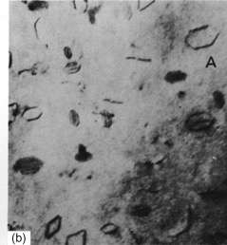
High T Radiation Effects in SiC
Above 1000C, Frank loops of the interstitial type become the dominant defects observed by TEM
Interstitial Frank loops are faulted, in that they include a stacking fault
Consequently, these loops cannot glide and will not move under an applied stress or temperature, and are therefore considered as sessile
At high temperature, the development of Frank loops into dislocation networks through unfaulting reactions at high doses is reported
Frank loops in Al

Slide 13
High T Radiation Effects in SiC
The volume associated with dislocation loops in irradiated SiC has been estimated to be on the order of 0.1%
At high T (greater than about 1500 K) vacancies are sufficiently mobile and vacancy clusters can be formed
This high T regime is the void swelling regime
1130 C, 1.8 dpa
1130 C, 8.5 dpa
1280 C, 5.0 dpa
1450 C, 1.8 dpa
1450 C, 5.0 dpa
1450 C, 8.5 dpa
Evolution of voids in high-temperature irradiated CVD SiC.

Slide 14
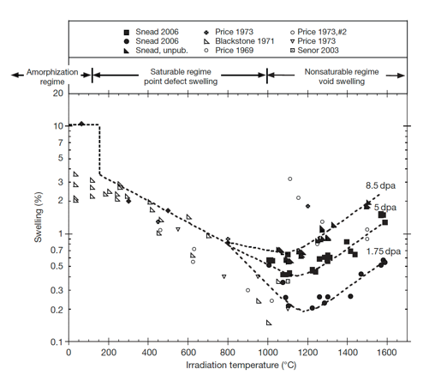
Irradiation-Induced Swelling in SiC
The transition from point-defect saturated swelling to void swelling occurs above 1000C
Void swelling increases as a function of dose, and is not known to saturate
The swelling near the critical amorphization temperature is described as the differential strain between the single interstitial, or tiny interstitial clusters, immobile vacancies, and antisite defects

Slide 15
Irradiation-Induced Swelling in SiC
Above the critical amorphization temperature, the number of defects surviving recombination is reduced and the mobility of both silicon and carbon interstitials becomes significant
Above 1000 C microstructural studies have noted the presence of both Frank loops and tiny voids, indicating limited mobility of vacancies
The max irradiation temperature shown is 0.65 T_{melt}

Slide 16
Irradiation-Induced Swelling in SiC
In typical fcc metal systems void swelling typically begins at ~0.35Tm, goes through a maximum value, and decreases to nil swelling by ~0.55Tm
The voids in SiC are continuing to grow in SiC irradiated to 1773 K, thus the energies for diffusion of either the Si or C vacancy or both must be quite high
This has been confirmed through DFT methods
It is unclear how swelling will increase as a function of dose above 10 dpa

Slide 17
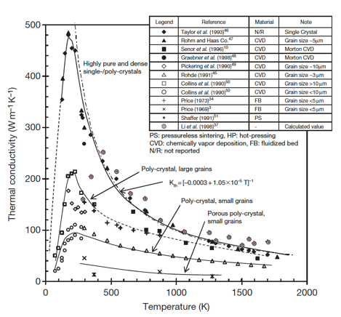
Thermal Conductivity Degradation
SiC is a ceramic with a band gap, and thus thermal conductivity is based on phonons
The conduction heat can be generally described by the strength of the individual contributors to phonon scattering: grain boundary scattering; phonon–phonon interaction; and defect scattering
Each of these types occurs at differing phonon frequencies and can be considered separable

Slide 18
Thermal Conductivity Degradation
The unirradiated k_{th} is highly dependent upon initial microstructure and temperature
Initial microstructure can be tailored, but the temperature dependence cannot be removed

Slide 19
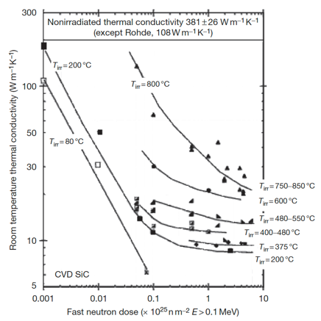
Thermal Conductivity Degradation
At low temperatures irradiation produces simple defects and defect clusters that very effectively scatter phonons
In this case, defect scattering quickly dominates, with saturation thermal conductivity typically achieved by a few dpa
Defect scattering is sufficiently present to eliminate the temperature dependence

Slide 20
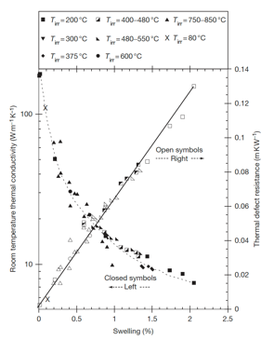
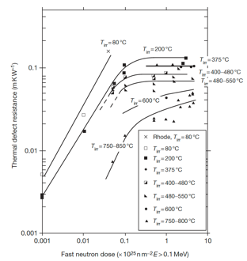
Thermal Conductivity Degradation
The thermal defect resistance is defined as the difference between the reciprocals of the irradiated and nonirradiated thermal conductivity (1/K_{rd} = 1/K_{irr} – 1/K_{nonirr})
This term can be related directly to the defect type and concentration present in irradiated ceramics
The thermal defect resistance is directly proportional to the irradiation-induced swelling in SiC, and is independent of temperature
This allows an indirect determination of thermal conductivity by measurement of the density change in the TRISO SiC shell

Slide 21
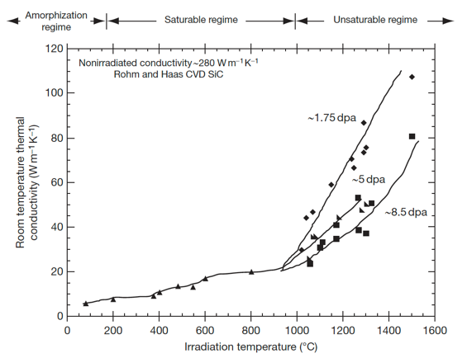
Thermal Conductivity Degradation
In the high temperature void swelling regime, thermal conductivity degradation is not expected to saturate, as voids continue to grow and scatter phonons
Additionally, the linear relationship between swelling and thermal defect resistance does not exist at high temperature
Generally, void swelling does not degrade thermal conductivity as severely as point defects, but data at high T is quite limited

Slide 22
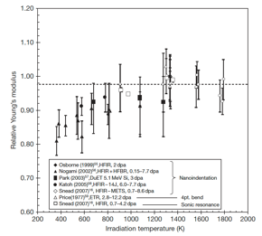
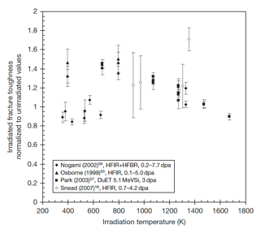
SiC Mechanical Properties
Irradiation generally reduces modulus to a greater extent for lower temperature irradiation, while the modulus reduction becomes negligible when irradiation temperature reaches or exceeds 1273 K
Irradiation-induced toughening (increase in fracture toughness) seems to be significant at 573–1273K in spite of the decrease in elastic modulus
However, there is significant scatter in the data

Slide 23
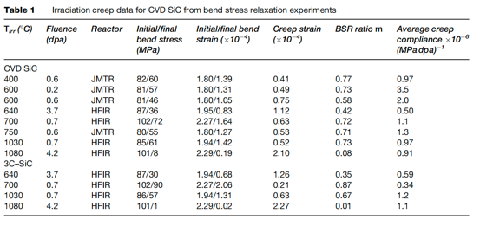
SiC Creep
Irradiation creep is defined as the difference in dimensional changes between a stressed and an unstressed sample irradiated under identical conditions
Studies on irradiation creep of SiC have been limited, although it is of high importance for SiC in TRISO particles
The creep strain for CVD SiC exhibited a weak temperature dependence at <0.7 dpa whereas a major transition at higher doses likely exists at higher temperatures

Slide 24
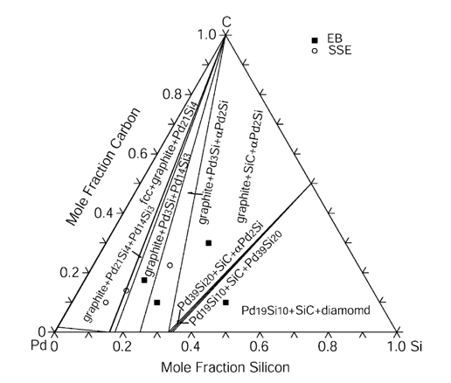
SiC Corrosion
The silicon carbide layer serves as a critical fission product barrier, but can be corroded by fission products, in particular palladium
Additionally, silver can be transported through intact SiC layers
For Pd, the reaction with SiC can be qualitatively explained by the phase-diagram, where a number of intermetallic structures are present
To prevent corrosion by Pd, new combinations of coating layers have been proposed

Slide 25
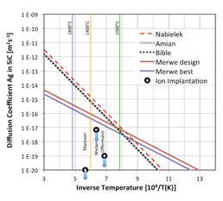
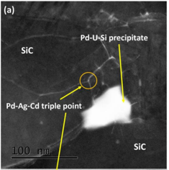
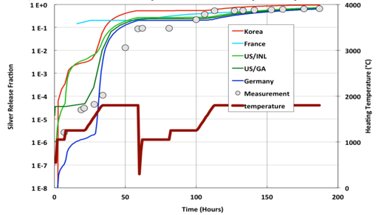
SiC Corrosion
Silver release has been observed from undamaged particles suggesting that Ag migrates through intact SiC layers at temperatures >1100 C
The Ag migration mechanism remains not fully understood, but is still an active area of research
Ag release has a temperature dependence, pointing towards a diffusive mechanism
From microstructural analyses, it seems possible that Ag, Cd and Pd cluster and transport together at grain boundaries and triple points because of their common chemical properties

Slide 26
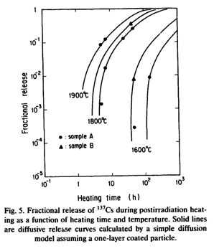
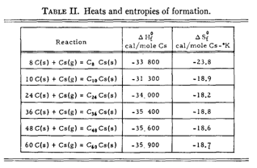
SiC Corrosion
Once cesium has migrated into the buffer, it can react with carbon
At nominal temperatures, cesium may be released and associated with carbon of the buffer layer to form compounds
These compounds, if they are not stable with increasing temperatures, may become a potential source of cesium release
Typically, cesium-graphite compounds are not stable at 923 K under vacuum and decompose to give cesium vapor and graphite

Slide 27
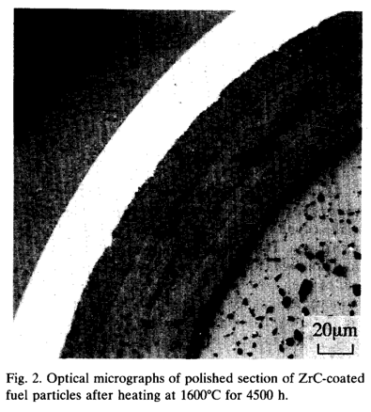
SiC vs ZrC Corrosion
An approach to counteract SiC fission product corrosion is to replace the SiC coating by a ZrC layer
Experimental observations showed neither Pd attack nor thermal degradation of ZrC up to 1600C
ZrC was also shown to have a high capacity to retain Cs, but poor retention of Ru
At higher T, the deterioration of the ZrC particle is caused by failure of the IPyC
The development of TRISO with ZrC-coating is at an early stage compared to the SiC-coated design

Slide 28
Questions?

Slide 29
Project Assignments
Mahmoud: The role and effect of silver on SiC in TRISO particles
Hamdy: High temperature materials for gas reactor heat exchangers
Khadija: SiC as a cladding material (non-TRISO applications)
15-20 minute PowerPoint presentation on Sept 9
Summarize what and why and key aspects

